Slide 2
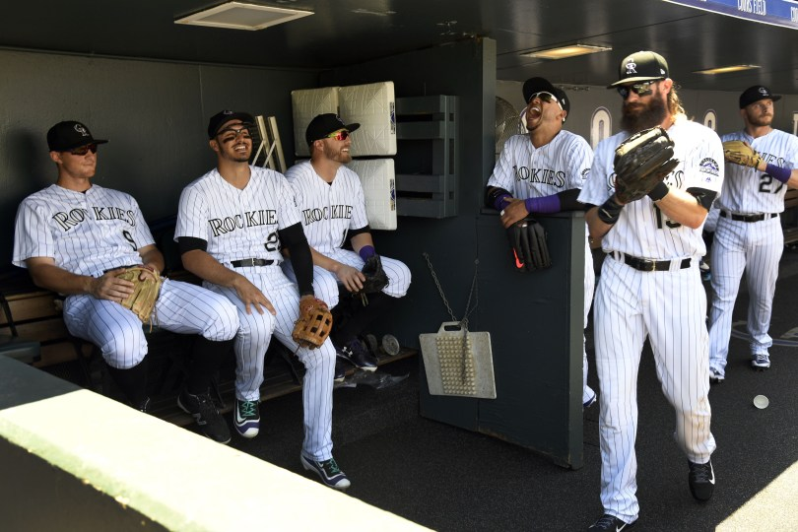
What is fantasy baseball?
The aggregation of player statistics in multiple positions; stats then feed to a scoring system

Slide 3

Challenge
Player statistics spread across multiple web pages
Data presentation solely in tables
Rankings system dependent upon perception over projection

Slide 4



Graphical Visualization / Machine Learning Analysis
Benefit
Opportunity
Analytical Ease
Single webpage creates data aggregation
Visual Intelligence
Dashboard utilizes in-depth, side by side tables and graphs
Player Assessment
Player list demonstrates over and under valuation of players

Slide 5
The Ultimate Fantasy Baseball Tool: Overview
Agility – Hitters’ and Pitchers’ pages utilize key stats used for player acquisition targets; two player comparison capability
Advancement – Machine Learning models past statistics to predict overall scores; ranks them to mimic Average Draft Position (ADP)
Assessment – Creation of scores to discover over-valued and under-valued players relative to ADP

Slide 6
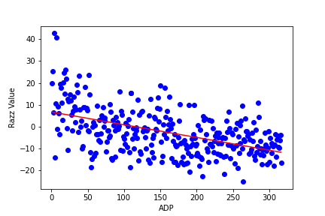
Distribution of ADP versus actual year end ranking
Graph of ADP versus the year end scoring for the 2019 season; ADP is a poor predictor of the value for the actual year;
R² = .256

Slide 7
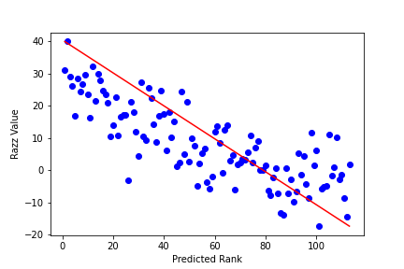
Our Predictions versus
Actual Scores
Our model’s hitter predictions graphed with the actual scores;
R² = .616

Slide 8
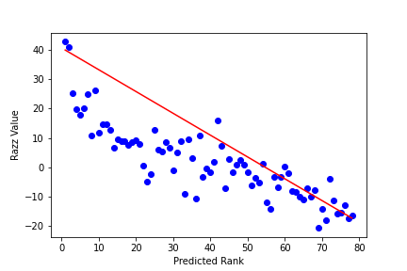
Our Predictions versus
Actual Scores
Our model’s pitcher predictions graphed with the actual scores;
R² = .818

Slide 9

Team
C - Daniel Kuchan
P - Joe Monahan
SS - Charles Ro
3B - Alex Torres

